Slide 1
Does Variability in Defensive Pass Coverage Schemes Lead to Successful Pass Defense?
By Peter Chapman
SPAX402: Predictive Analysis Using Athletics Data
The University of Delaware
December 9, 2025

Slide 2
Introduction and Research Question
Dallas Cowboys prioritized zone coverage for pass defense through Weeks 1-9
Very little man coverage as a result, especially compared to rest of the league
Fans have been critical of DC Matt Eberflus for strict dedication to zone defense
DAL defense struggled mightily during first 9 weeks of the 2025 season
Many successful DCs are known to throw different looks at the opposing offense
  Minnesota Vikings: Brian Flores
  Kansas City Chiefs: Steve Spagnuolo
  Philadelphia Eagles: Vic Fangio
Research Question: Does variability in defensive pass coverage schemes have a relationship with pass defense success in the NFL?
Focus of study: First 13 weeks of 2025 NFL season
Variation in defensive pass coverage schemes recorded for each NFL team so far in 2025

Slide 3
Key Defensive Pass Coverage Schemes
Ten different defensive pass coverage schemes used
PFF definitions used for descriptions of each scheme
Coverages are used selectively by each team
  Most common: Cover 1, Cover 3
  Least common: Cover 1 Double, Cover 3 Seam, Bracket Cover
Some coverages are very similar to each other
Coverage Name | Description
Cover 0 | A man-to-man coverage across the board with no deep defenders
Cover 1 | Any form of man defense across the board with a defensive player as a single High Man concept
Cover 1 Double | Double single High Man coverage when it is clear the defense is targeting to double one offensive receiver
Cover 2 | A two deep safety concept where any zone principle is applied; can include Tampa 2, 2 Traps, or 2 Combo/Match coverage
Cover 3 | Any 3 Deep, 4 Under concept
Quarter | Cover quarters; 4 Deep, 3 Under concept where the corners are on #1, safeties on #2, and backside safety rotation dependent on formation
Cover 6 | A quarters concept on half the field and a 2 Deep concept on the other half
Cover 2 Man | A 2 Deep safety concept where a man principle is applied; the underneath coverage will be in man across the board
Cover 3 Seam | A 3 Deep, 4 Under concept where the Curl/Flat defenders match #2 when they go vertical or out
Bracket Cover | When two offensive players have an in and out bracket by two defenders

Slide 4
Data Collection and Transformation
Pro Football Focus (PFF) was the source of most data
  Defensive pass coverage distribution for each NFL team in Weeks 1-13 of 2025
  Player grades for each defensive player in both 2024 and 2025
2025 pass defense outcomes for each team provided by Sumer Sports
  Raw defensive stats such as pass yards, pass touchdowns, and total Expected Points Added (EPA)
  Efficiency statistics such as completion percentage, EPA/Play, and EPA/Pass
Data transformation consisted of four steps
  Calculate the average coverage grades for cornerbacks and safeties by team from 2024-2025
  Find the average grade for pass rushers by team from 2024-2025
  Quantify variability in the key defensive pass coverage schemes for each team
  Organize all variables for each team in one data frame (.csv file)

Slide 5
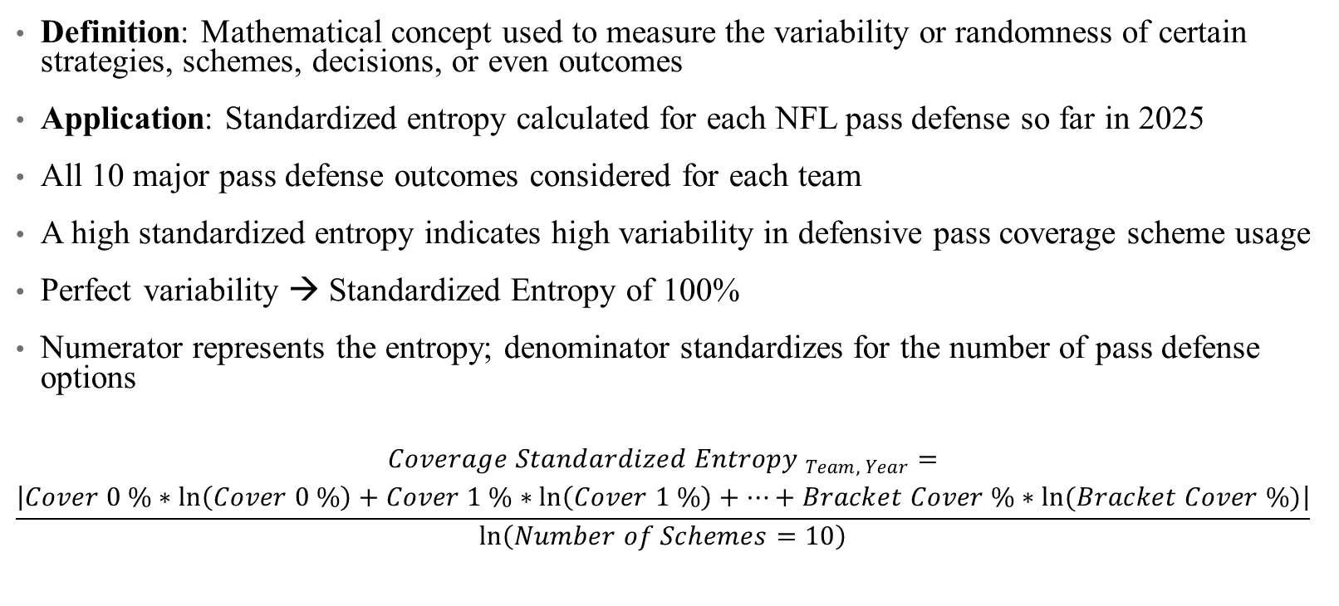
Standardized Entropy
Definition: Mathematical concept used to measure the variability or randomness of certain strategies, schemes, decisions, or even outcomes
Application: Standardized entropy calculated for each NFL pass defense so far in 2025
All 10 major pass defense outcomes considered for each team
A high standardized entropy indicates high variability in defensive pass coverage scheme usage
Perfect variability → Standardized Entropy of 100%
Numerator represents the entropy; denominator standardizes for the number of pass defense options
$$\begin{aligned}{Coverage Standardized Entropy }_{Team, Year}= \\ \frac{\left|Cover 0 \%∗\ln\left(Cover 0 \%\right)+Cover 1 \%∗\ln\left(Cover 1 \%\right)+…+Bracket Cover \%∗ln(Bracket Cover \%)\right|}{\ln\left(Number of Schemes=10\right)}\end{aligned}$$

Slide 6
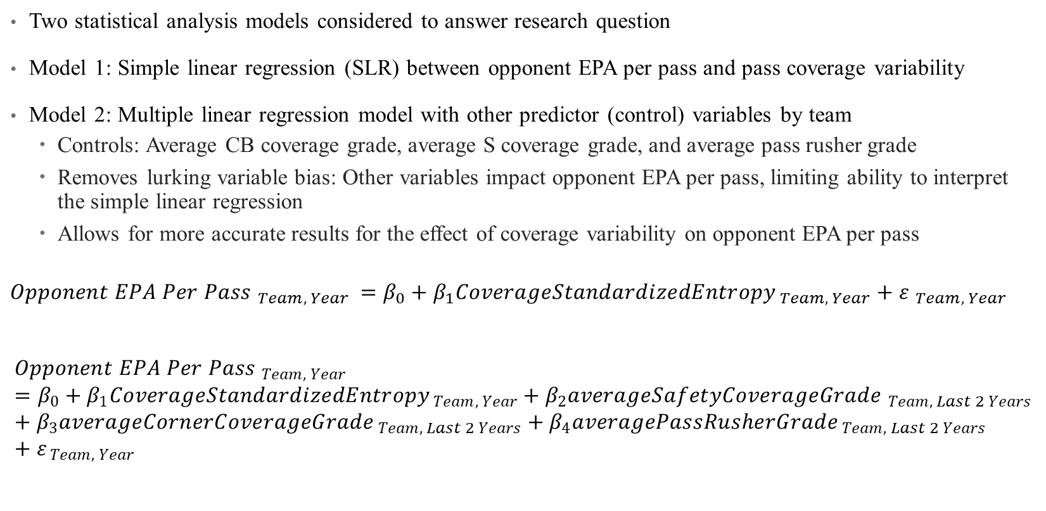
Regression Models
Two statistical analysis models considered to answer research question
Model 1: Simple linear regression (SLR) between opponent EPA per pass and pass coverage variability
Model 2: Multiple linear regression model with other predictor (control) variables by team
  Controls: Average CB coverage grade, average S coverage grade, and average pass rusher grade
  Removes lurking variable bias: Other variables impact opponent EPA per pass, limiting ability to interpret the simple linear regression
  Allows for more accurate results for the effect of coverage variability on opponent EPA per pass
$${Opponent EPA Per Pass }_{Team, Year }={β_{0}+β_{1}CoverageStandardizedEntropy}_{ Team, Year}+{ε }_{Team, Year}$$
$${Opponent EPA Per Pass }_{Team, Year}={β_{0}+β_{1}CoverageStandardizedEntropy}_{ Team, Year}+β_{2}{averageSafetyCoverageGrade }_{Team, Last 2 Years}+β_{3}{averageCornerCoverageGrade}_{ Team, Last 2 Years}+β_{4}{averagePassRusherGrade}_{ Team, Last 2 Years}+ε_{ Team, Year}$$

Slide 7
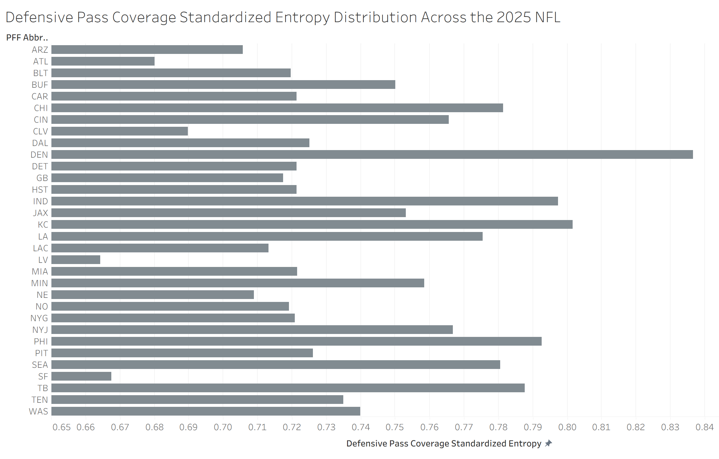
League-Wide Distribution of Defensive Pass Coverage Standardized Entropy
High: Denver Broncos, 83.66%
Low: Las Vegas Raiders, 66.43%

Slide 8
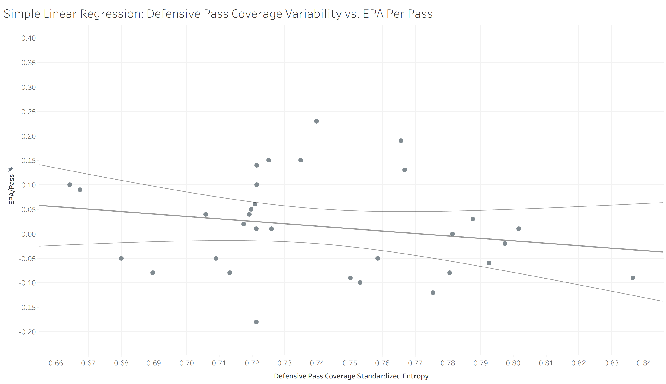

Simple Linear Regression Model Results
$${\hat{Opponent EPA Per Pass}}_{ Team, 2025}=0.384144 −0.498298{ Standardized Entropy }_{Team, 2025}$$
R-Squared: 4.19%
P-Value: 0.261051

Slide 9
Multiple Linear Regression Results
$$\hat{{Opponent EPA Per Pass }_{Team, 2025}}={0.09764−0.3899CoverageStandardizedEntropy}_{Team, 2025}−4.66936{averageSafetyCoverageGrade}_{Team, 2024−2025}−0.71344{averageCornerCoverageGrade}_{Team, 2024−2025}−0.29354{averagePassRusherGrade}_{Team, 2024−2025}$$
Two relevant predictor variables
  Average cornerback coverage grade
  Average pass rusher grade
Variables may be clinically significant
  Defensive pass coverage standardized entropy
  Average safety coverage grade
Defensive pass coverage variability has become less important; positional grades hold more importance in determining opponent EPA per pass
Lurking variable bias has been partially addressed, but other variables can still be added
Variable | Coefficient | P-Value
Coverage Standardized Entropy | -0.3899 | 0.3559
Average Safety Coverage Grade | -4.66936 | 0.5424
Average Cornerback Coverage Grade | -0.71344 | 0.0448
Average Pass Rusher Grade | -0.29354 | 0.0503
Constant | 0.09764 | 0.7729

Slide 10
Conclusion and Future Research
Wide range of defensive pass coverage variability results in the 2025 NFL Weeks 1-13
  Low: Las Vegas Raiders, 66.43%
  High: Denver Broncos, 83.66%
Defensive pass coverage standardized entropy had similar results in both models
  Negative relationship with opponent EPA per pass
  Statistically insignificant at most statistical significance levels
  May still hold clinical significance from a coaching perspective
Average PFF grades by position had negative relationships with opponent EPA per pass
Conclusion: More research should be performed using the MLR model
  Add more control variables to model to eliminate more lurking variable bias
    PFF grades
    Offensive EPA per pass
    Injuries on both sides of the football
  Different dependent variable of interest
    Expected points added per drop back (EPA / drop back)
    Interception rate (INT%)

